Slide 1
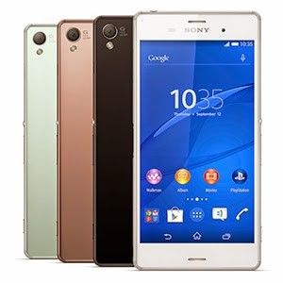
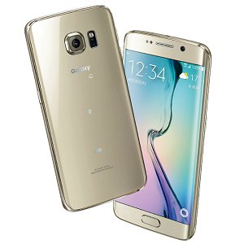
Promo deals for Limited time ONLY!
*Special conditions applicable for those who will change phone from other companies
一括
実質
0
0
￥84,240
Xperia Z4
円
円
一括
実質
0
0
￥81,000
Galaxy S6
円
円
※ In the case of support in special contract agreement

Slide 2
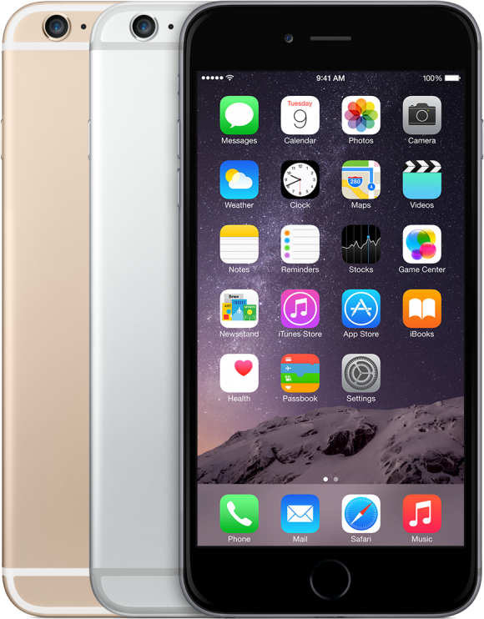
￥200,000
(Get a Cash back up to this maximum amount )
iPhone6
For 2 Family contracts
For those who will transfer to au from other companies using the same number
MNP…………………………….……..￥20.000
For old phone………………………￥20.000
Multiple cells premium………..￥20.000
Au Dealer premium……...……..￥20.000
Family premium……...…………..￥3.000
Family Plus………………………….. ￥10.000 x 2 =￥20.000

Slide 3
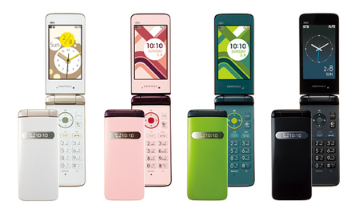
GRATINA2
￥20,000 Cash back
For 2 contracts in a family
Charge from ￥2/month
MNP ¥ 20.000 / Trade-in ¥ 10,000 / ¥ 20,000 more than two units

Slide 4
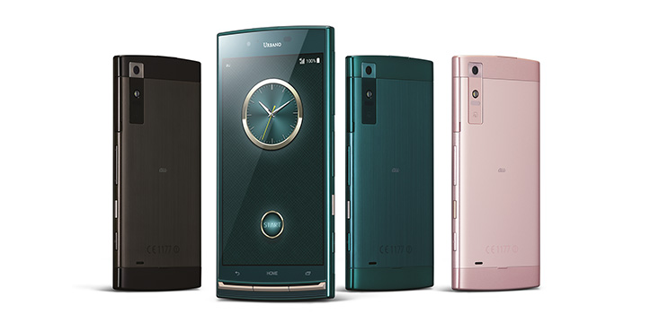
Amazing Smartphone Deals!
Limited time ONLY!
URBANV02
￥２.１５９/month
Transfer from other carrier
using the same number
And Get BIG DISCOUNT on monthly plan!!
UNLIMITED CALL on au
between 1:00 to 21:00+ Mail + 7GB net data
※auスマートバリューご加入時

Slide 5
10/10～１０/12
3DAYS only!
Thanksgiving Promo!
Visit us and enjoy this benefits!!!
Benefit①: Get a chance on lottery raffle!
Garapon lottery
Every ticket is a winner!!!
Benefit②: Candy fill-all-you-can!
Kids will receive free sweets &
candies all they can!!!
3Days Event all featured products are available!

